Slide 1
A Tableau Tool for Strategic Enrollment Management
Norma Fewell, Wendy Lin, Steve Graunke
IUPUI

Slide 2
Our Presentation Today
Philosophy of Strategic Enrollment Management (SEM)
IUPUI Institutional Research and Decision Support project to assist with SEM
Demonstrating Reports
Admissions Funnel
Enrollment and Orientation Point in Cycle
Course Enrollment Point in Cycle
Where we go from here

Slide 3
We did not do this alone! Thank You!
Michele Hansen
Cheryl Stine
Teresa Troke
Stephen Hancock
Jessicah Rauch
Clif Marsiglio
Barb Dobbs
Nicole Collins
Melissa Pollauf

Slide 4
What is Strategic Enrollment Management?

Slide 5
What is Strategic Enrollment Management?
“a comprehensive approach to integrating all of the University’s programs, practices, policies, and planning related to achieving optimal recruitment, retention, and graduation of students” (Wilkinson, Taylor, Peterson, & de Lourdes Machado-Taylor, 2007)
Integrated with mission, vision, strategic plan.
Holistic – entire career considered
Not just recruitment.
Student success is an enrollment management function!

Slide 6
Optimize Enrollment Management
SECTION TITLE GOES HERE IF NECESSARY
“IUPUI will create a strategic and coordinated enrollment management plan to attract, retain, and graduate better prepared, more diverse students who choose IUPUI first for its vibrant urban location, leading academic programs, and culture of learning in engagement with local, regional, national, and global communities.”

Slide 7
Optimize Strategic Actions
Implement a strategic, proactive enrollment management plan to expand enrollment of undergraduate, graduate, and professional students at the Indianapolis campus and increase the number of degrees awarded at the baccalaureate and graduate/professional levels.
Shorten the length of time needed to complete an undergraduate degree.
Establish a Division of Enrollment Management led by a senior-level administrator charged with implementing the campus’s enrollment planning and management activities.
Implement recruitment and retention strategies and ensure that the campus policies, processes, and data infrastructure necessary for accomplishing goals are in place.

Slide 8
IUPUI Institutional Research and Decision Support (IRDS) project to assist with SEM

Slide 9
SEM 360 project
Previous Microsoft Reporting Services
Want something more interactive
Better back-end data
Better drill down capability
School/Program
Demographics

Slide 10
SEM 360 project
Help with several decisions
Enrollment projections
Diversity enrollment
Optimal number of class sections
Close sections or open more?
Course enrollment trends
One big system → Series of reports

Slide 11
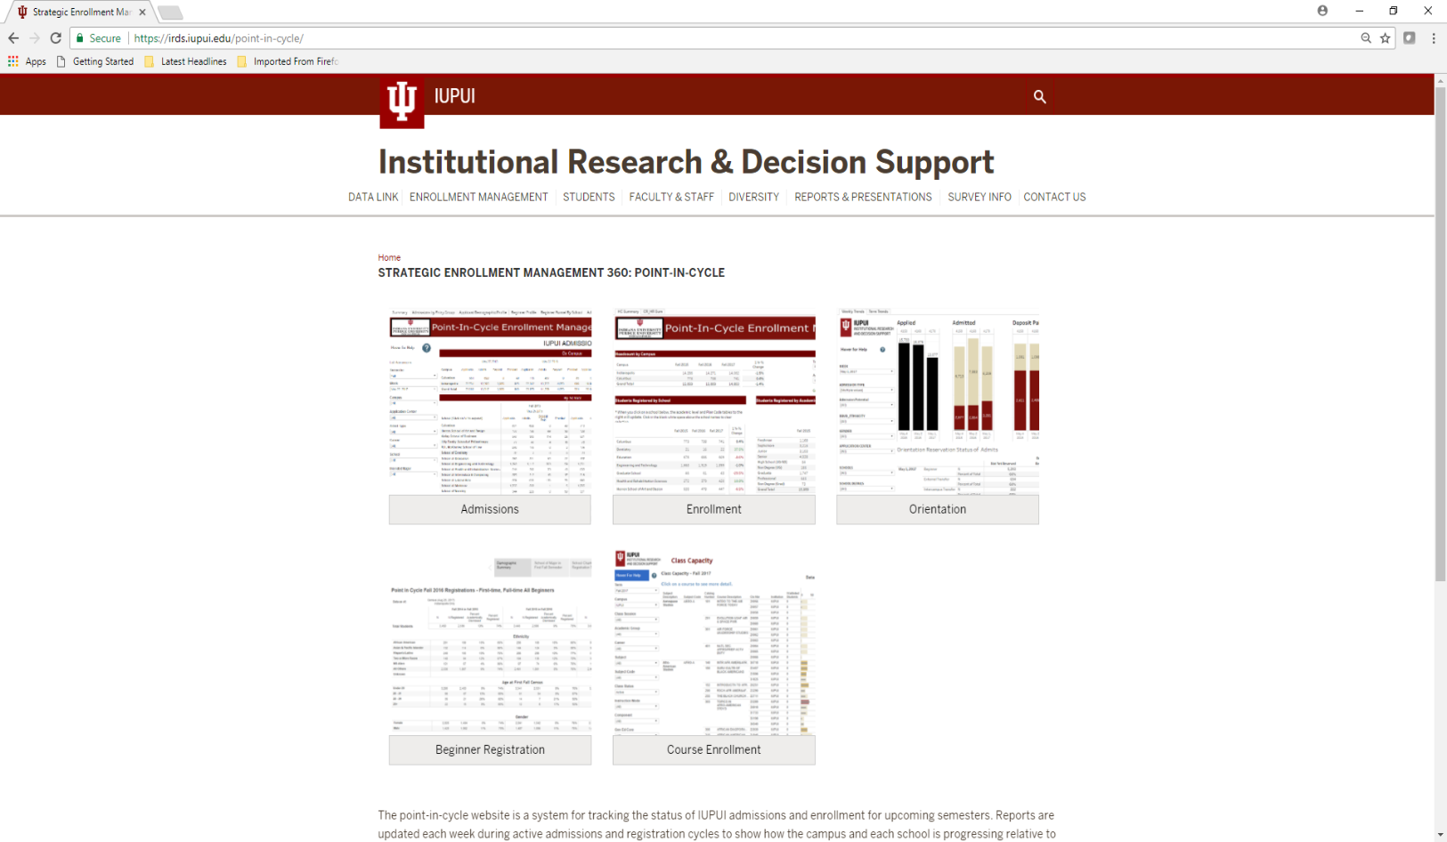
SEM 360 project
Rebuild Existing Point-in-Cycle (PiC) reports
UIRR Prototype (thanks again Cheryl!)
Refine data visualizations for IUPUI
Final product

Slide 12
Report Demonstration

Slide 13
Admissions Point-in-Cycle
Updated weekly
View by Admissions Cycle/or Semester
Intended majors groups Pre- and Direct Admits
Sub-reports available :
By Admit Type
Demographic Profile
Beginner Profile (Academic Readiness)
Funnel by School
Trends

Slide 14
Orientation Point-in-Cycle
Helps determine if additional Orientation sessions are needed.
Updates weekly combining Admissions and Orientation data
Indianapolis Campus Only
Indicates Orientation status:
Reserved an Orientation time
Attended Orientation
Not Yet Reserved
Would like to add Housing data

Slide 15
Course Enrollment Point-in-Cycle
Serves as a tool to monitor course enrollment to determine if an increased class capacity may be needed.
Assist planning for future semesters.
Consists of both real-time and historic trend data.

Slide 16
Course Enrollment Point-in-Cycle
Main Reports:
Class Capacity provides a view of all courses offered.
Class Capacity - Combined Sections looks at courses where multiple sections are taught together at the same time and place.
Class Capacity - Block Enrollment Classes includes Block enrollment sections where two or more courses must be taken together.
High/Low Capaity looks at courses where enrollment capacity >= 90%, below 10 head counts or that are potentially affected by the institutions' low course enrollment policy.

Slide 17
Course Enrollment Point-in-Cycle
Sub-Reports:
Class Faculty Attributes provides information on primary instructor by class number, component, class status, and number of waitlisted students.
Class Student Attributes provides information on students enrolled in the course by major, race/ethnicity, average high school GPA, cumulative GPA, and average transfer credit hours and others.
Enrollment by Group provides enrollment headcount and percent to capacity by week day and time offered and by mode of instruction.
Class Enrollment Trends displays historic enrollment trends over time to allow point-in-cycle comparison.

Slide 18
Next Steps

Slide 19
Next Steps
Enrollment
Student Level Data
Orientation Point-In-Cycle
Add housing information
Course Enrollment
Add transfer credit information

